Slide 1
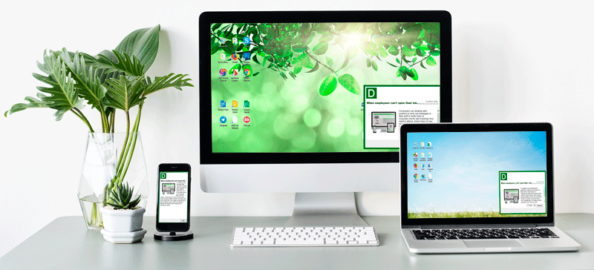

Desktop Notification

Slide 2
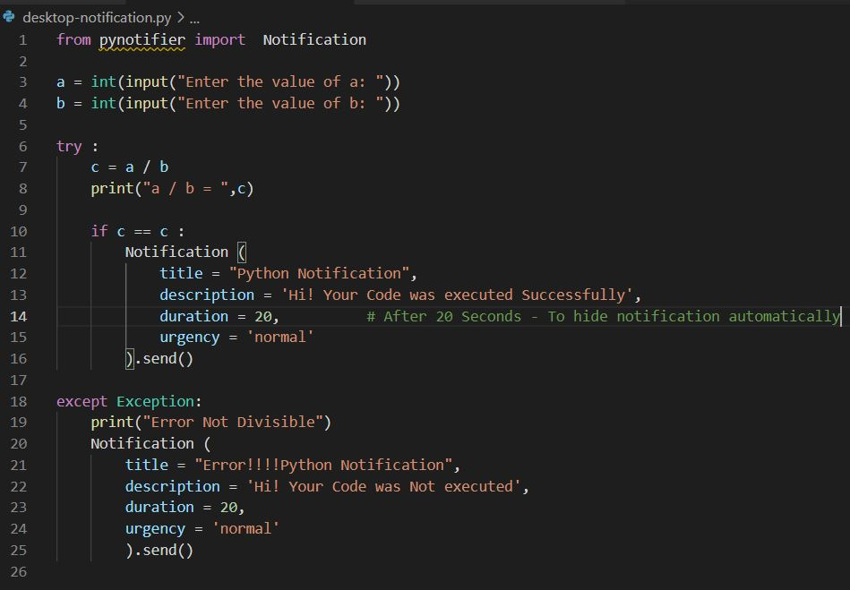
Python Snippet
Install pynotifier in Python <pip install py-notifier>
--> For generating Desktop Notification

Slide 3
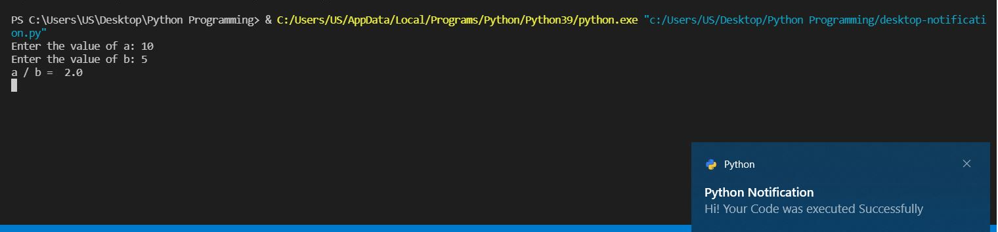
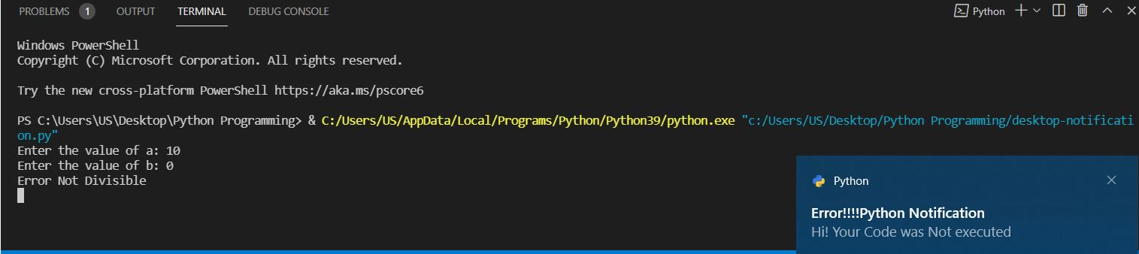
Output:

